Slide 1






Local Development Plans
Workshop on new evidence
31 March 2026

Slide 2















LDPs Workshop on new evidence
Purpose
To consider the implications of new evidence for different parties.
To identify action to be taken where new evidence arises, such as the 2022 household projections, for example, establish a set of principles to inform local authority action.

Slide 3
Agenda
10:30 | Introduction from Chair – Carrie Thomson, Head of Development Planning and Housing | 5 mins
10:35 | LDP context and data – Reanne Sutton, PARD | 10 mins
10:45 | Implications of new evidence
 | Homes for Scotland - tbc | 10 mins
 | Heads of Planning Scotland – tbc | 10 mins
11:15 11:20 12:05 | DPEA - Alison Kirkwood Comfort break Discussion on actions to address new evidence post Gate Check/pre-Proposed Plan Working in 2 groups Is a consistent approach possible? Could a set of principles to guide action be workable Feedback to the room | 10 mins 5 mins 45 mins 15 mins
12:40 | Actions agreed/next steps | 10 mins
12:30 | Meeting close

Slide 4
LDP context and data

Slide 5
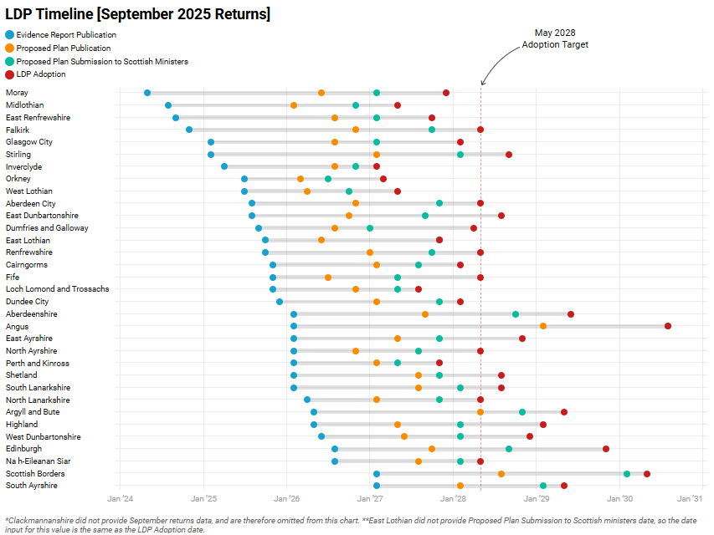
LDP Timelines (September 2025)
Every 6 months Planning Authorities are asked to provide an anticipated timeline of LDP adoption
Dates include:
  Evidence Report Publication
  Proposed Plan Publication
  Proposed Plan Submission to Ministers
  LDP Adoption

Slide 6
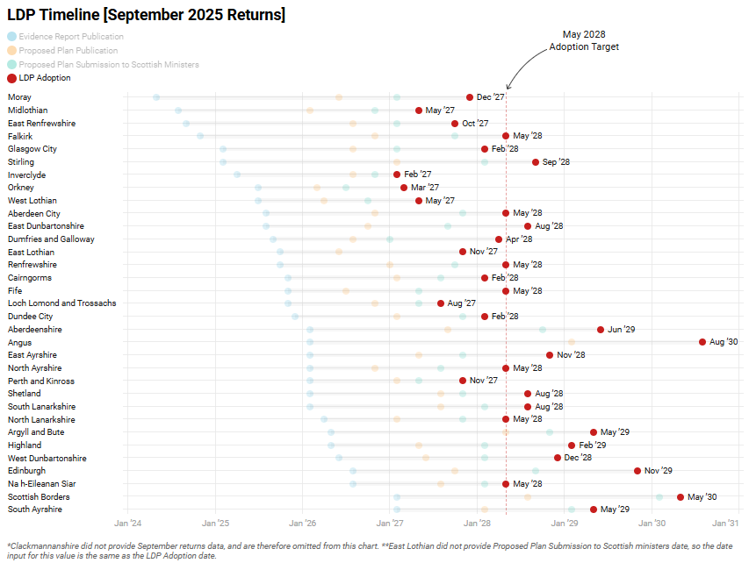
LDP Timelines (September 2025)
May 2028 LDP adoption target highlighted
Mixed picture amongst planning authorities

Slide 7
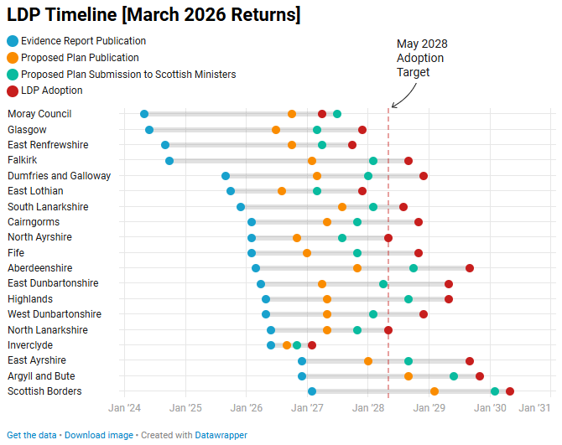
LDP Timelines (March 2026)
Planning Authorities are currently submitting updated timelines for the March 2026 returns
We have 19 of 34 returned as of 27th March

Slide 8
Evidence Report Data
Minimum All-Tenure Housing Land Requirement (MATHLR) defines the minimum amount of land, measured in housing units, that local authorities must allocate over a 10-year period.
The Indicative Local Housing Land Requirement ( iLHLR ) is produced by authorities and should exceed the MATHLR
Notes:
The Minimum All Tenure Housing Land Requirement (MATHLR) is calculated by the Scottish Government for each local authority, combining household projections, existing housing need, and a 25-30% flexibility allowance over a 10-year period.
The Indicative Local Housing Land Requirement ( iLHLR ) is produced by authorities and should exceed the MATHLR

Slide 9
National Records of Scotland Household Projections (2022)
Area Name | 2022 | 2032 projection | Household Growth | Household Growth (percentage)
The National Records of Scotland produce household projections data.
This table shows the 10-year projection (from 2022 to 2032) in population growth for Local Authority areas
Notes:
Minimum All-Tenure Housing Land Requirement (MATHLR) defines the minimum amount of land, measured in housing units, that local authorities must allocate over a 10-year period. This is provided to planning authorities.
The Indicative Local Housing Land Requirement ( iLHLR ) is produced by authorities and should exceed the MATHLR

Slide 10
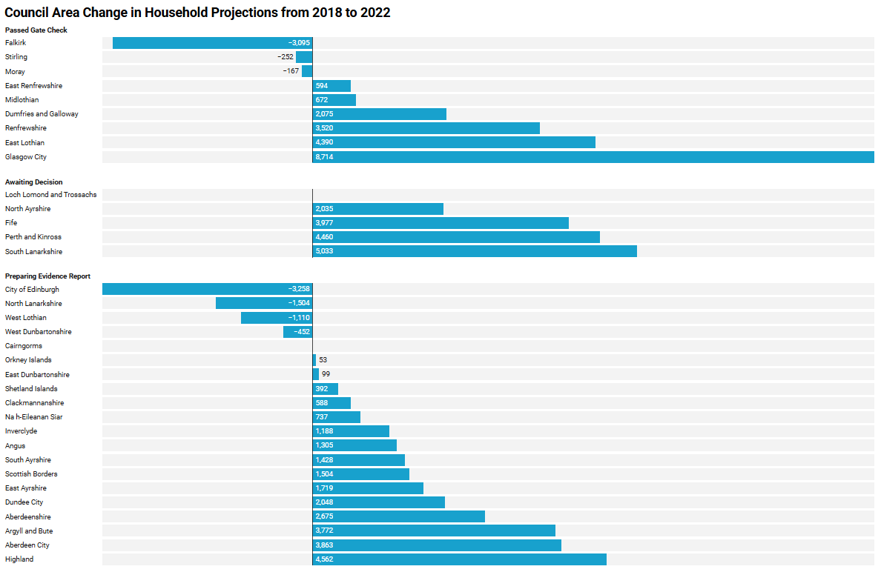
Differences between Household Projection Data
The National Records of Scotland produced household projection forecast in 2018 and 2022
This chart shows the difference in those projections for the year 2032
It shows the degree to which the evidence has changed
 | 2022 Population | First Prediction | Second Prediction | Difference
Falkirk | 72,567 | 78,144 | 75,049 | -3095

Slide 11
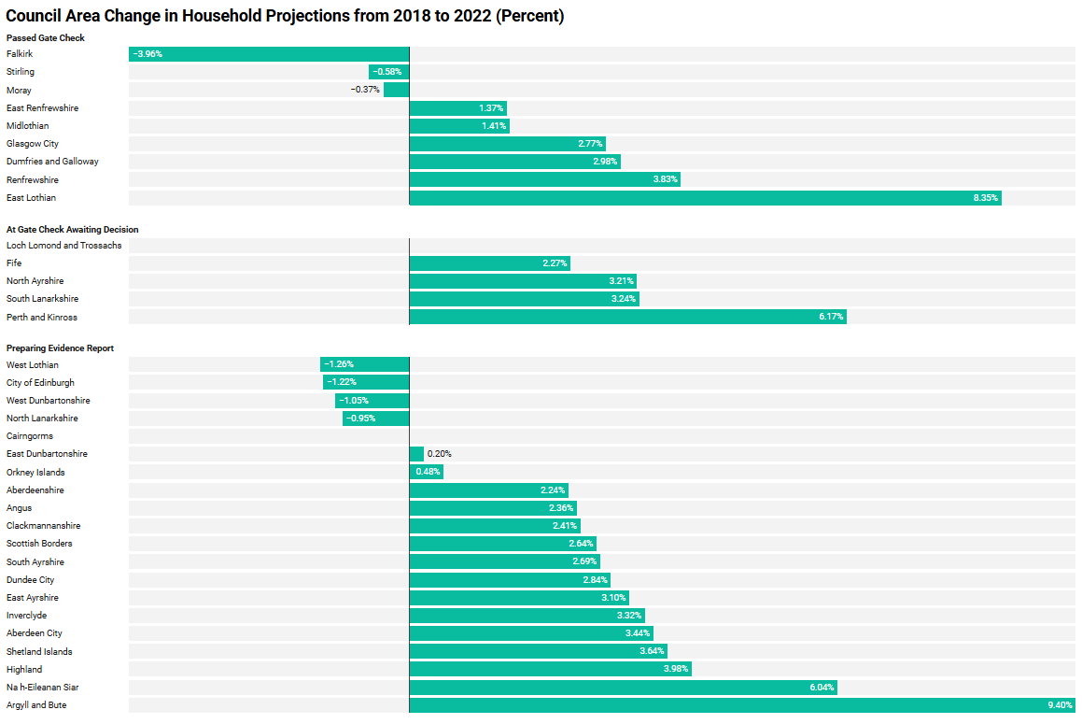
Changes in Household Projection Data
(as a percentage)
This chart shows the same dataset, but as a change in percentages rather than raw numbers.
 | 2022 Population | First Prediction | Second Prediction | Decrease
Falkirk | 72, 567 | 78,144 | 75,049 | -3.95%

Slide 12
Homes for Scotland

Slide 13
Heads of Planning Scotland

Slide 14
DPEA

Slide 15
Addressing new household projections
Evidence reports yet to be submitted for gate check
  Evidence reports expected to reflect the up-to-date position at the time of submission to gate check
  Chief Reporter’s letter dated 18 March 2026
  Advice to address new household projections in advance of submission and with relevant stakeholders.
  Would apply to re-submissions

Slide 16
Addressing new household projections
Evidence reports currently at gate check
  Procedure notices issued seeking further written information
  - Authority to consider implications of new household projections
  - Encouraged to engage with relevant stakeholders
  - Opportunity to withdraw evidence report

Slide 17
Addressing new household projections
Evidence reports already found to be sufficient
at gate check
  No legislative provision or expectation to formally revisit evidence report
  To do so would have timescale and cost implications
  2022 household projections unlikely to be the only change in period between Gate Check and Proposed Plan.

Slide 18
Dealing with New or Updated Evidence
Proposed Plan
  Inevitability of new evidence arising post gate check
  The more so if lengthy gap between gate check and proposed plan
  Need for Proposed plans to respond to most up-to-date information
  This may involve moving on from position set out in the evidence report, potentially including the iLHLR
  Ongoing engagement with/ by stakeholders – don’t wait for the representations stage
  Benefits of transparency and inclusion - avoid surprises
  Advice – keep records of engagement and any changes from position set out in evidence report

Slide 19
Dealing with New or Updated Evidence
Examination
  Can only address issues raised in representations
  Focus of evidence will change from evidence report stage
  Reporters will be wary of dismissing new information if it is relevant, even if it emerges late in the day
  But highly challenging to address substantive far-reaching and cross-cutting matters at the examination stage
  Implications for cost and timescales

Slide 20
Discussion
Is a consistent approach possible?
Could a set of principles to guide action be workable?

Slide 21
Agenda
10:30 | Introduction from Chair – Carrie Thomson, Head of Development Planning and Housing | 5 mins
10:35 | LDP context and data – Anne Grove and Reanne Sutton | 10 mins
10:45 | Implications of new evidence
 | Homes for Scotland | 10 mins
 | Heads of Planning Scotland | 10 mins
11:15 11:20 12:05 | DPEA - Alison Kirkwood Comfort break Discussion on actions to address new evidence post Gate Check/pre-Proposed Plan Working in 2 groups Is a consistent approach possible? Could a set of principles to guide action be workable Feedback to the room | 10 mins 5 mins 45 mins 15 mins
12:40 | Actions agreed/next steps | 10 mins
12:30 | Meeting close

Slide 22
Feedback

Slide 23
Thank you

